Slide 1


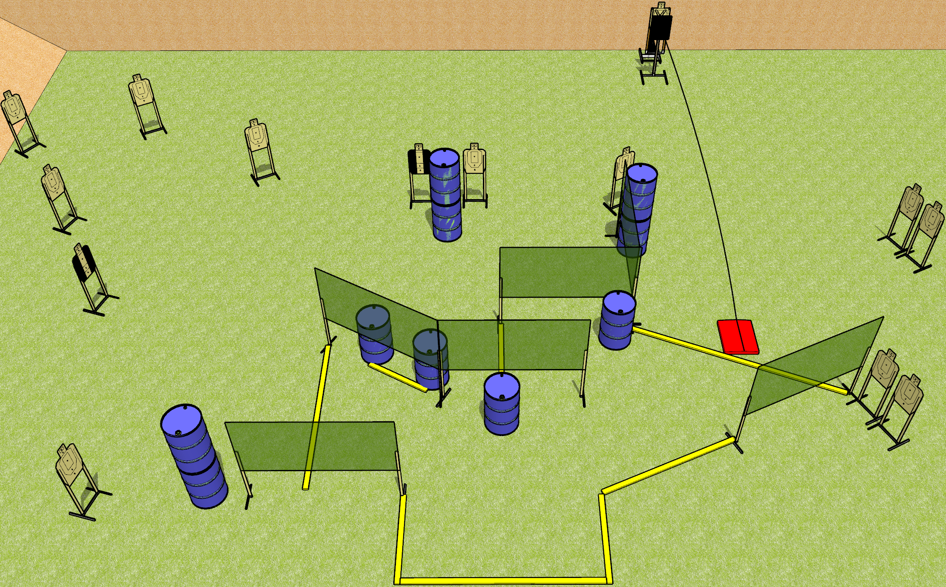
 | Dothan Gun Club – USPSA Match Hello Down There Course Designer : Drew Coleman
START POSITION : Standing with heels against rearmost fault line, wrists below belt
GUN READY CONDITION : Pistol loaded and holstered. PCC loaded, held with both hands, stock on belt, safety on. |  | SCORING: Comstock, 28 rounds TARGETS: 14 paper, 0 Steel SCORED HITS: Best 2 on paper, steel until down START-STOP: Audible, last shot RULES: Bobber must be activated before being engaged. The stomp box is part of the shooting area. The area with the barrels and fault line under the wall is considered a port.
STAGE PROCEDURE: Engage targets as they become available from within the fault lines. All magazines to be used for reloading must come from barrels inside the shooting area.

Slide 2
Hello Down There
Written Stage Briefing
Hello Down There is a 28 round, 140 point, Comstock field course. There are 14 USPSA targets. The best two hits on paper will score. The start signal is audible.
The bobbing target is activated by the stomp box, and it must be activated before being engaged. The stomp box is part of the shooting area. Please check the activator prior to walkthrough, and set it the same way every time.
Handgun start position is inside the shooting area, heels touching rearmost fault line, wrists below belt. Handgun is loaded and holstered.
PCC start position is inside the shooting area, heels touching rearmost fault line. Loaded carbine is held with both hands, stock on belt, safety on.
All magazines to be used for reloading must come from barrels in the shooting area. The area with the barrels and the fault line under the wall is a port.
On start signal, engage targets as they become available from within the shooting area.

